Slide 1
REAL TIME TRANSIT INFORMATION PLATFORM

Slide 2
Real-time information, broadly defined, means any information available to transit providers or customers about the current status of vehicles, including approximate locations and predictive arrival times. Most real-time information relies on automatic vehicle location (AVL) and Global Positioning Systems (GPS) in order to estimate approximate arrival times for passengers and transit system operators. Passengers access real-time arrival and departure information through dynamic signs at stops and stations, or through the Internet at home or on smartphones. As smartphones become more prevalent, they have made access to third-party scheduling information and apps highly accessible for passengers.

Slide 3
Mobile Technology
Because cellular phones and smartphones are so prevalent today, they can be very useful for disseminating real-time transit information. Mobile phones allow passengers to use SMS (or Short Message Service) to access schedule and real-time information via text message. This is a two-way method of communicating wherein the passenger can send a text message to an agency, usually with a code for the stop they want information about. The agency then automatically sends a response with the next bus’ arrival times. These services do not necessarily always use real-time information, instead responding with the next scheduled bus arrival time. However, real time information makes texting more useful to customers.

Slide 4
Computer vision: By utilizing data from parking lot cameras, computer vision technology identifies vacant parking spaces.
Deep learning: Deep learning employs AI neural networks that have been exposed to comprehensive parking data. Similar to humans, these systems learn from experience, becoming more accurate as they collect and analyze more data.
Ground sensors: Ground sensors utilize radar technology to detect parking space availability. These sensors are strategically placed across the parking lot floor.

Slide 5
Parking counter systems: These legacy smart parking technologies count the number of vehicles entering or exiting a parking lot.
Automated parking lots: Drivers leave their vehicles in a designated area, where sensors and lasers scan and measure the vehicle’s dimensions. Subsequently, a moving platform lifts and transfers the vehicle to an available parking space.
Self-driving cars: Many cars now come equipped with self-parking features, enabling drivers to park their vehicles automatically without being behind the wheel. This advancement streamlines the parking process and maximizes the utilization of parking spaces.

Slide 6
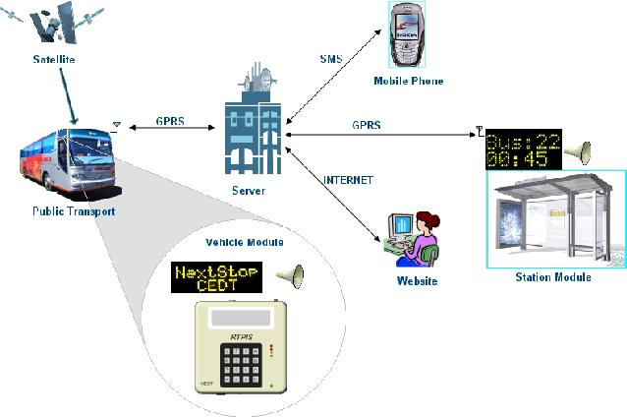
The Internet of Things (IoT): The IoT refers to the interconnectedness of various devices via online communication. IoT systems enable drivers to access real-time information about available parking spaces through websites or dedicated apps. With this technology, drivers can plan their parking ahead of time, significantly reducing the time spent searching for a spot. The advantages of IoT in parking extend beyond assisting drivers in finding parking spaces. These systems also help businesses optimize parking lot occupancy, promote their services across multiple platforms, and contribute to a reduction in carbon emissions resulting from drivers aimlessly circling in search of parking.

